Slide 1
Habit Helper
by Stanislav Delyukov & Sviatoslav Fediaev
team 17

Slide 2
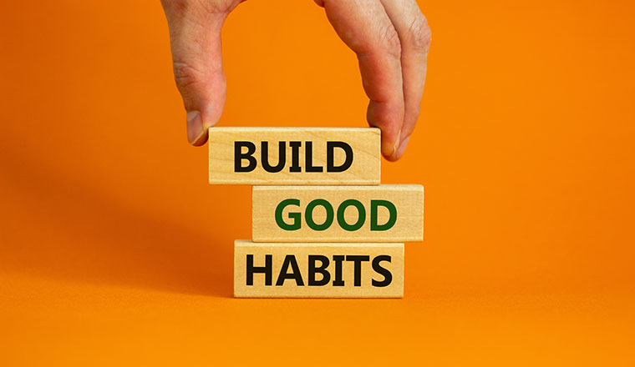
Problem
The “Habit Helper” project aims at helping to develop habits. It is useful, since nowadays people often forget about their health, basic things, scheduled trainings, and etc.
Development of habits with the app will become several times easier, because the “Habit Helper” will remind user to do certain things, when needed.

Slide 3
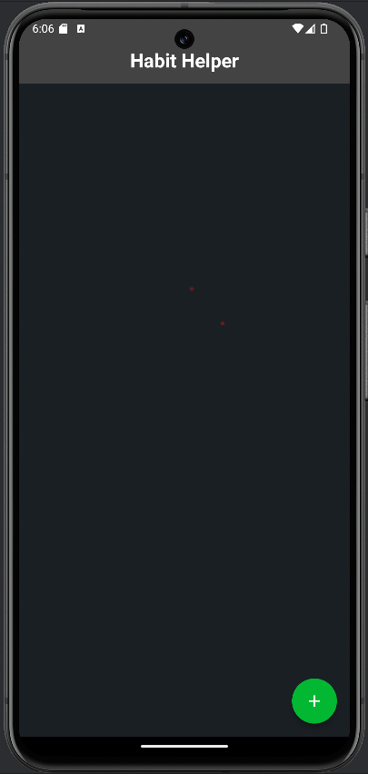
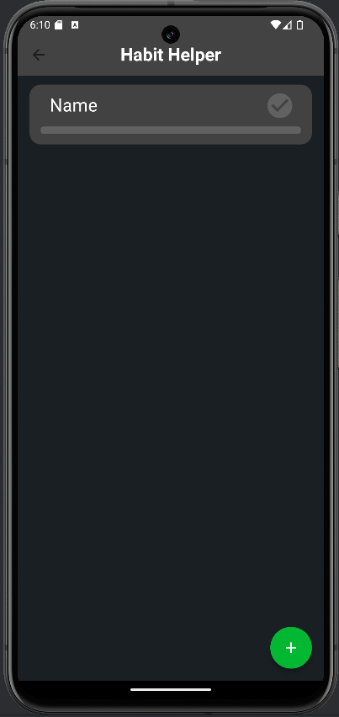
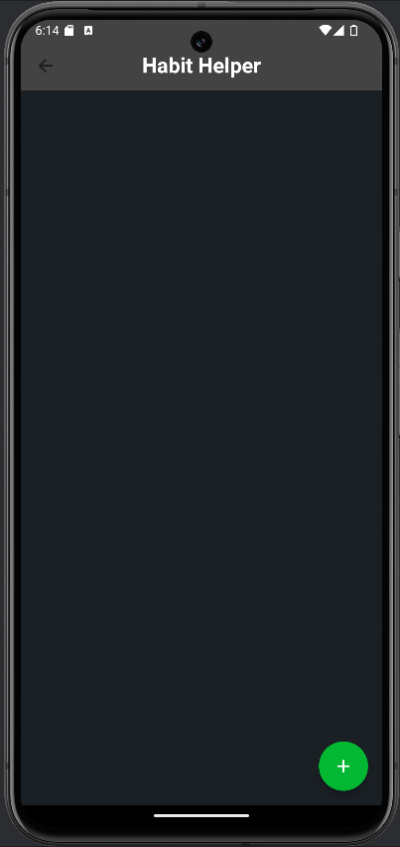
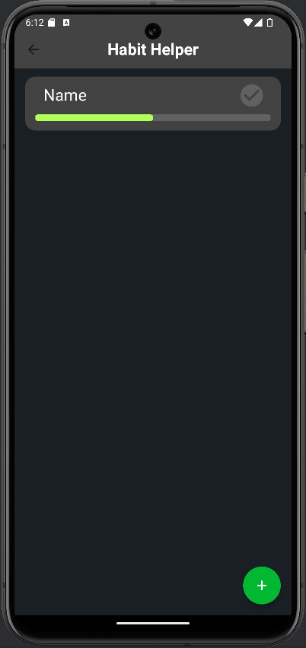
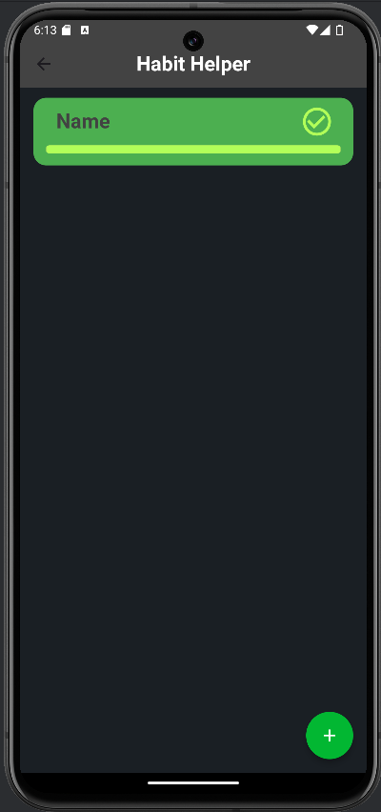
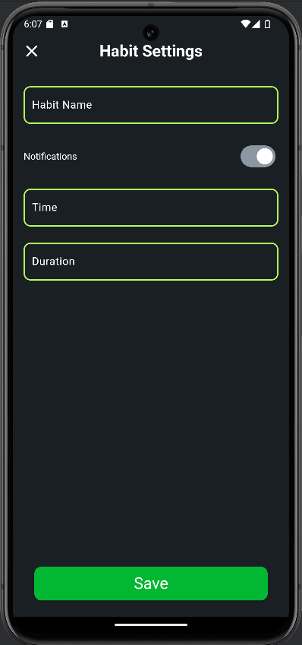
Features
The “Habit Helper” project allows a user to:
Create a new habit;
Delete a habit;
Check in the habit completion;
Set the amount of repetitions of the habit;
And other functions for which we didn’t have enough time.

Slide 4
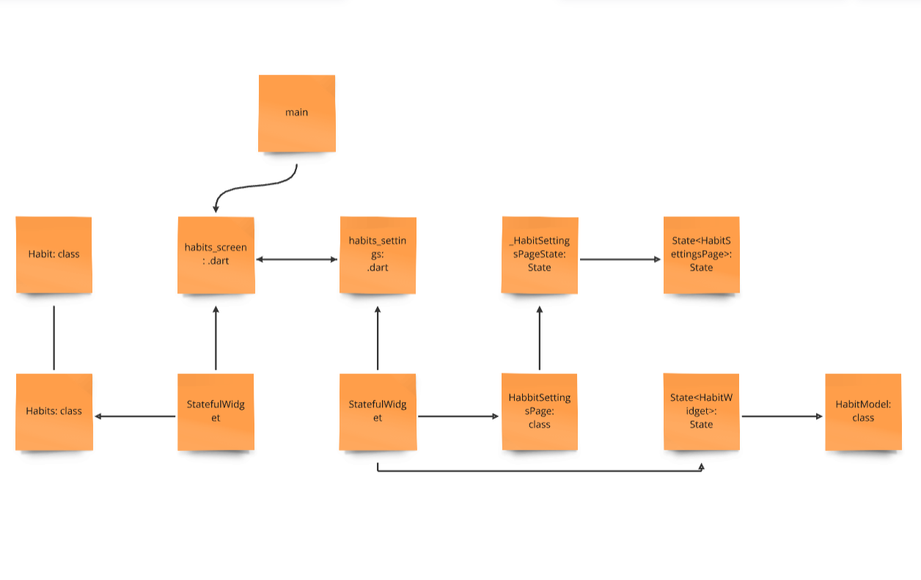
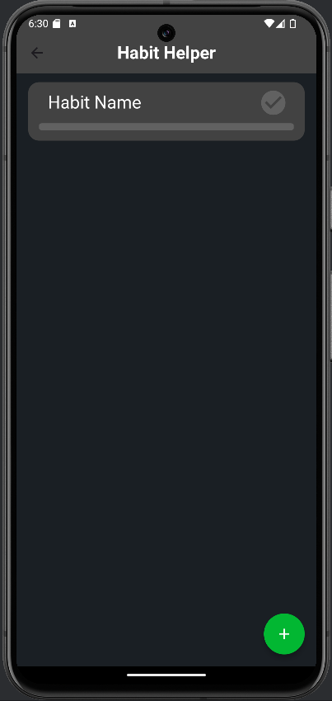

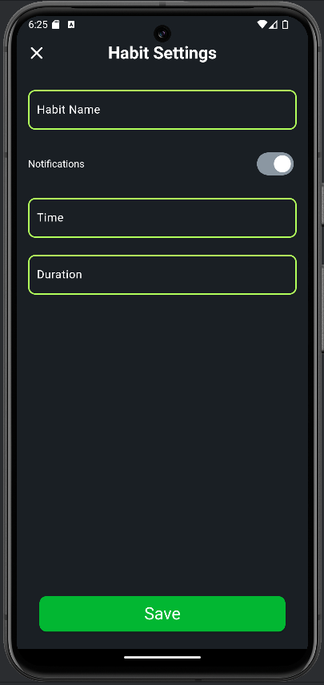
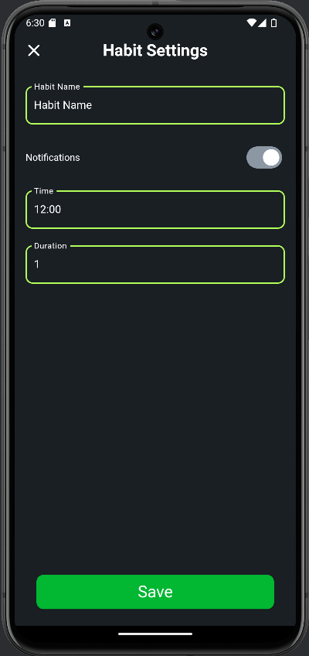
Diagram
Diagram
Return without save
Save
Create a habit

Slide 5
Challenges & Solutions
We were given with only a week of the time(less than a week)
We didn’t understand how local storing works
We forgot how to create and modify widgets
Everything broke multiple times
We worked fast
We learned how it works
We repeated everything again
Stanislav fixed it

Slide 6

Demo
Now, let us show how it works.

Slide 7
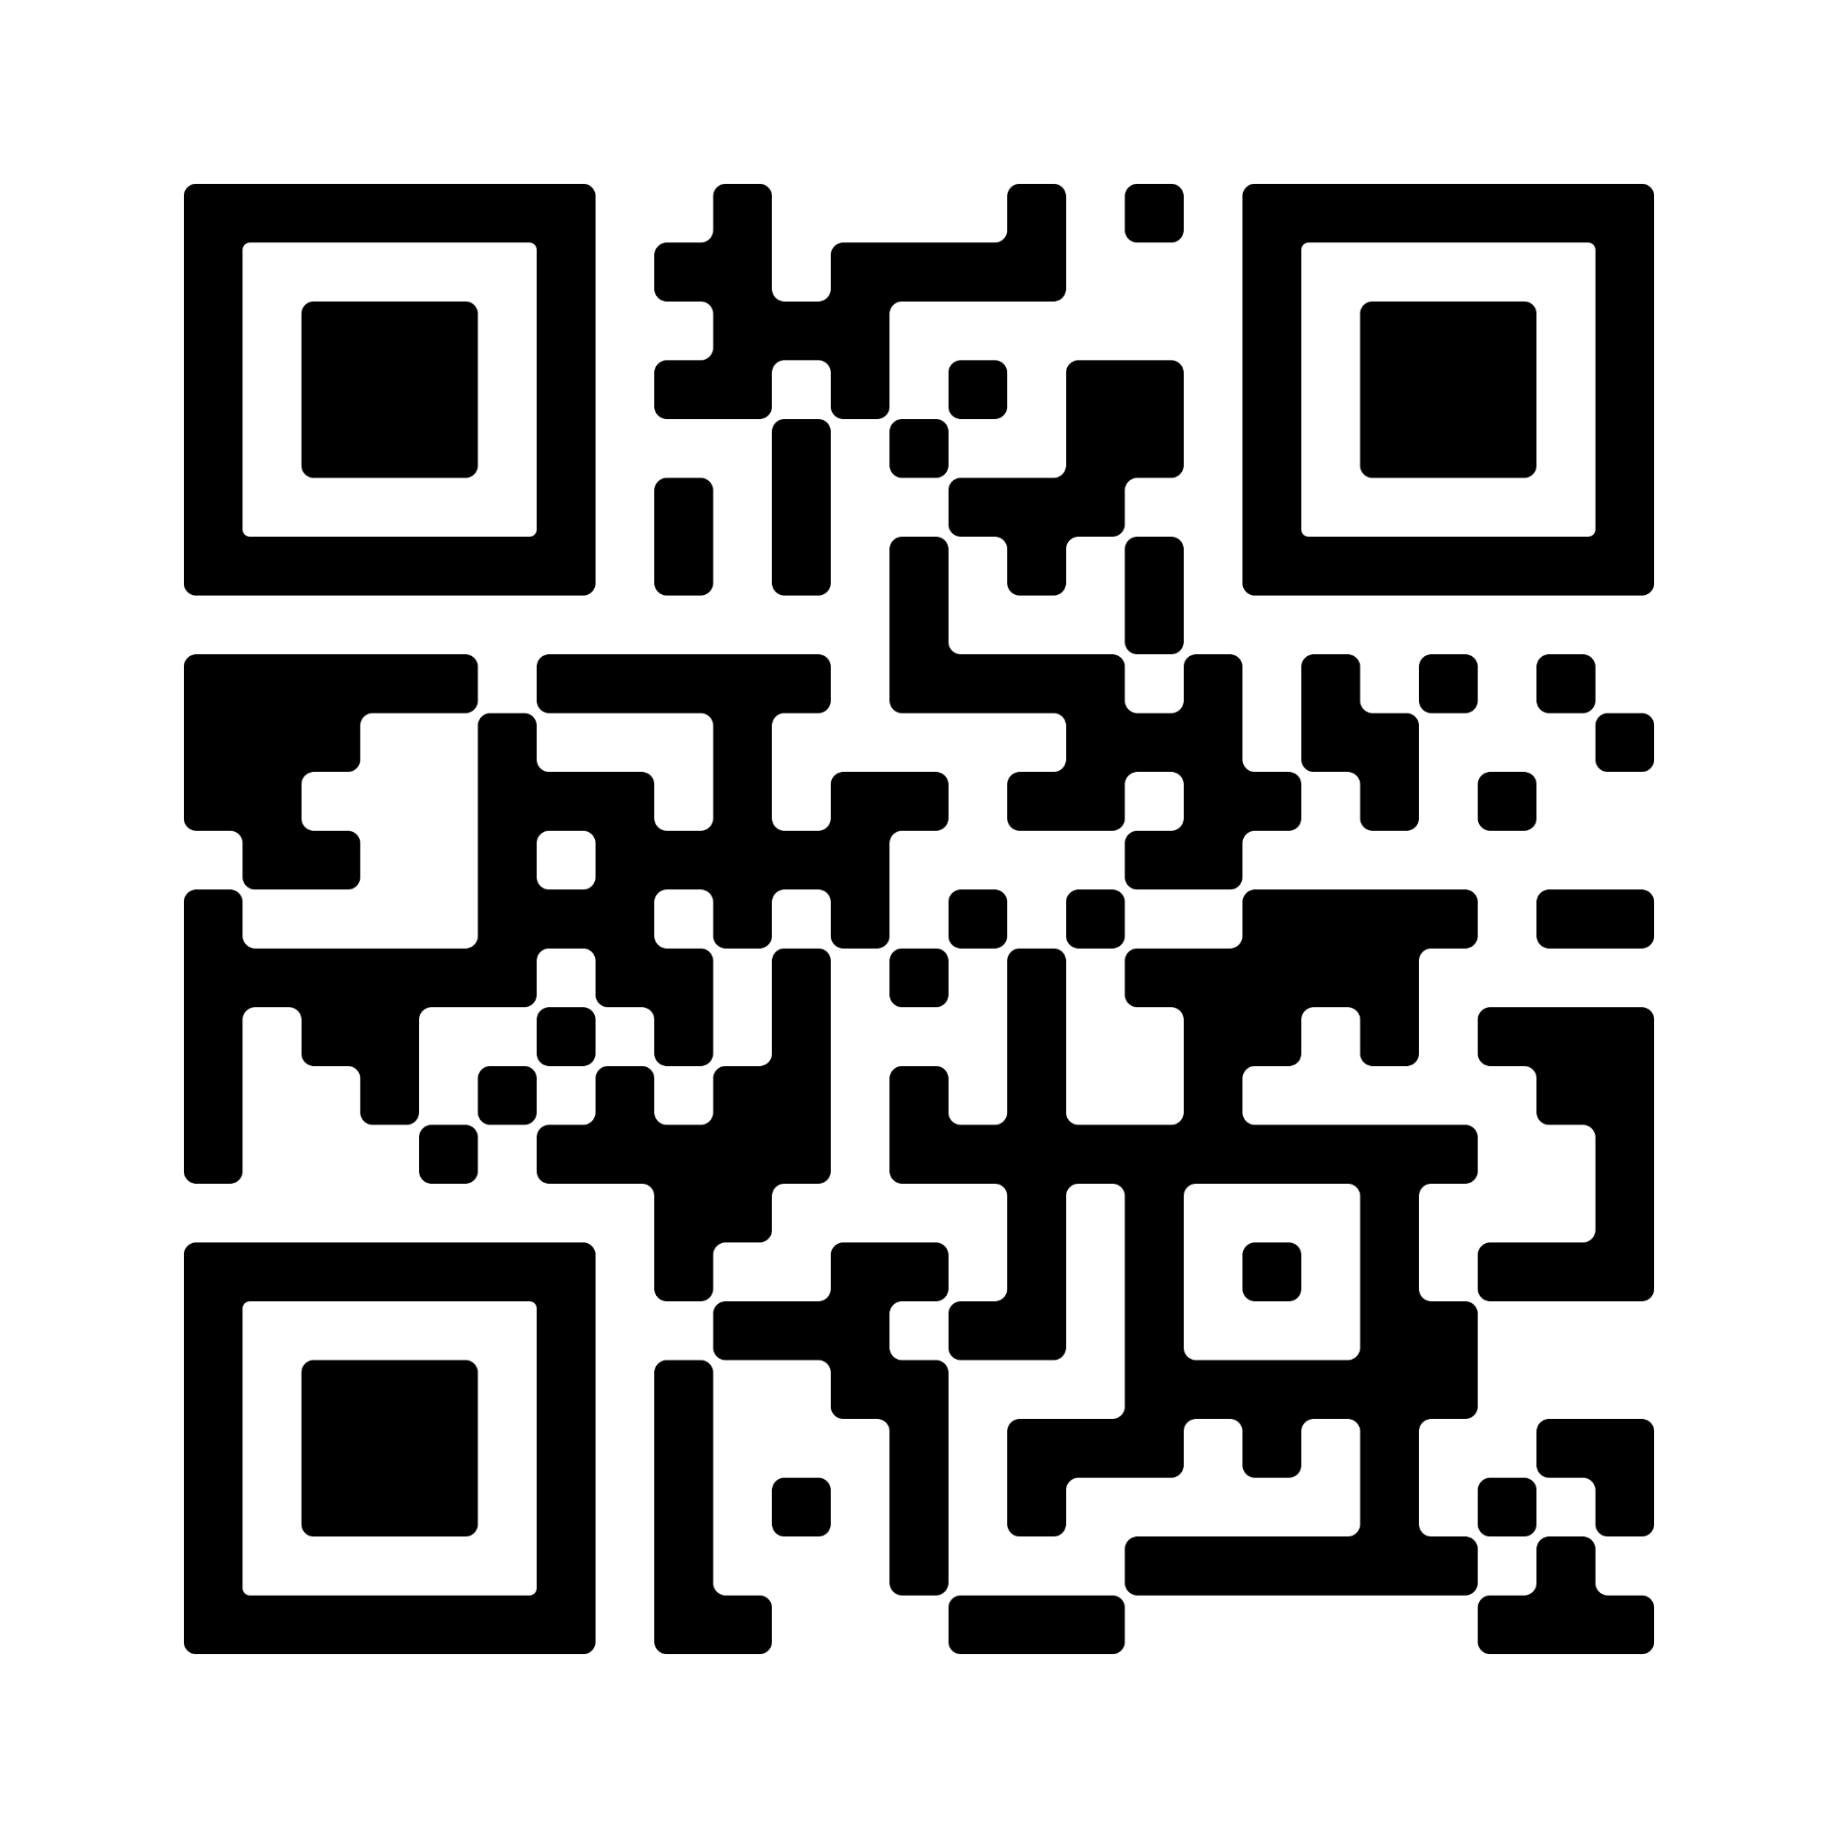
Our github repository

